Slide 1

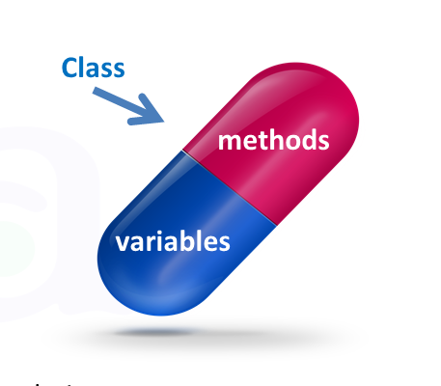


Encapsulation
What is Encapsulation, Benefits
C# OOP
Basics
SoftUni Team
Technical Trainers
Software University
http://softuni.bg

Slide 2

Table of Contents
What is Encapsulation?
Keyword this
Access Modifiers
State Validation
Mutable and Immutable Objects

Slide 3
Questions
sli.do #CSharp-Fund

Slide 4

Encapsulation
Hiding Implementation

Slide 5


Encapsulation
Process of wrapping code and data together into a single unit
Class fields must be private
Use getters and setters for data access
private int age;
class Person
{
public int Age => return this.age
}
Notes:
Encapsulation hides the implementation details
Class announces only a few operations (methods) available for its clients – its public interface
All data members (fields) of a class should be hidden
Accessed via properties (read-only and read-write)
No interface members should be hidden
Encapsulation == hide (encapsulate) data behind constructors and properties

Slide 6
Encapsulation – Example
Fields should be private
- == private
Person
-name: string
-age: int
+Person(string name, int age)
+Name: string
+Age: int
+ == public
Properties should be public
Notes:
Fields are private
Constructors and accessors are defined (getters and setters)

Slide 7
Keyword this
this is reference to the current object
this refers to the current instance of the class
this can be passed as a parameter to other methods
this can be returned from method
this can invoke current class methods
public Person(string name)
{
this.name = name;
}
Notes:
Constructors are declared public
Constructors perform checks to keep the object state valid
Interface methods are always public
Not explicitly declared with public
Non-interface methods are declared private / protected

Slide 8
Keyword this (2)
this can invoke current class method
private string FirstName
{
get { return this.firstName }
}
public string FullName
{
return this.FirstName + " " + this.LastName
}
Notes:
Constructors are declared public
Constructors perform checks to keep the object state valid
Interface methods are always public
Not explicitly declared with public
Non-interface methods are declared private / protected

Slide 9
Keyword this (3)
this can be used for constructor overloading
public Person(string firstName, string lastName)
{
this.firstName = firstName;
this.lastName = lastName;
}
public Person (string firstname, string lastName, int age)
:this (firstName, lastName);
{
this.age = age;
}
Notes:
Constructors are declared public
Constructors perform checks to keep the object state valid
Interface methods are always public
Not explicitly declared with public
Non-interface methods are declared private / protected

Slide 10

Access Modifiers
Visibility of Class Members

Slide 11
Private Access Modifier
Main way to perform encapsulation and hide data from the outside world
private is the default field and method modifier
Avoid declaring private classes and interfaces
Can only be accessed within the declared class itself
private string name;
Person (string name)
{
this.name = name;
}
Notes:
Access Level "public"
When we use the modifier public in front of some element, we are telling the compiler, that this element can be accessed from every class, no matter from the current project (assembly), from the current package. The access level public defines the miss of restrictions regarding the visibility. This access level is the least restricted access level in Java.
Access Level "private"
The access level private is the one, which defines the most restrictive level of visibility of the class and its elements. The modifier private is used to indicate, that the element, to which is issued, cannot be accessed from any other class (except the class, in which it is defined), even if this class exists in the same package.
Access Level “protected"
The access level private is the one, which defines the most restrictive level of visibility of the class and its elements. The modifier private is used to indicate, that the element, to which is issued, cannot be accessed from any other class (except the class, in which it is defined), even if this class exists in the same namespace.
Access Level “default"
This is the default access level, i.e. it is used when there is no access level modifier in front of the respective element of a class. Members can be accessed only from the same package.

Slide 12
Protected Access Modifier
Can only be accessed by inherited classes
Avoid declaring protected classes and interfaces
Prevent a nonrelated class from trying to use it
class Person
{
protected string FullName { get; set; }
}
Notes:
Access Level "public"
When we use the modifier public in front of some element, we are telling the compiler, that this element can be accessed from every class, no matter from the current project (assembly), from the current package. The access level public defines the miss of restrictions regarding the visibility. This access level is the least restricted access level in Java.
Access Level "private"
The access level private is the one, which defines the most restrictive level of visibility of the class and its elements. The modifier private is used to indicate, that the element, to which is issued, cannot be accessed from any other class (except the class, in which it is defined), even if this class exists in the same package.
Access Level “protected"
The access level private is the one, which defines the most restrictive level of visibility of the class and its elements. The modifier private is used to indicate, that the element, to which is issued, cannot be accessed from any other class (except the class, in which it is defined), even if this class exists in the same namespace.
Access Level “default"
This is the default access level, i.e. it is used when there is no access level modifier in front of the respective element of a class. Members can be accessed only from the same package.

Slide 13
Internal Access Modifier
internal is the default class access modifier in C#
Accessible to any other class in the same project
class Person
{
string Name { get; set; }
internal int Age { get; set; }
}
Team rm = new Team("Real");
rm.Name = "Real Madrid";
Notes:
Access Level "public"
When we use the modifier public in front of some element, we are telling the compiler, that this element can be accessed from every class, no matter from the current project (assembly), from the current package. The access level public defines the miss of restrictions regarding the visibility. This access level is the least restricted access level in Java.
Access Level "private"
The access level private is the one, which defines the most restrictive level of visibility of the class and its elements. The modifier private is used to indicate, that the element, to which is issued, cannot be accessed from any other class (except the class, in which it is defined), even if this class exists in the same package.
Access Level “protected"
The access level private is the one, which defines the most restrictive level of visibility of the class and its elements. The modifier private is used to indicate, that the element, to which is issued, cannot be accessed from any other class (except the class, in which it is defined), even if this class exists in the same namespace.
Access Level “default"
This is the default access level, i.e. it is used when there is no access level modifier in front of the respective element of a class. Members can be accessed only from the same package.

Slide 14
Public Access Modifier
A class, method, constructor declared inside a public class can be accessed from any class belonging to the .NET World
To access class from a namespace you sould describe it inline
To access class directly from a namespace you can use the using keyword to include the namespace
public class Person
{
public string Name { get; set; }
public int Age { get; set; }
}
Notes:
Access Level "public"
When we use the modifier public in front of some element, we are telling the compiler, that this element can be accessed from every class, no matter from the current project (assembly), from the current package. The access level public defines the miss of restrictions regarding the visibility. This access level is the least restricted access level in Java.
Access Level "private"
The access level private is the one, which defines the most restrictive level of visibility of the class and its elements. The modifier private is used to indicate, that the element, to which is issued, cannot be accessed from any other class (except the class, in which it is defined), even if this class exists in the same package.
Access Level “protected"
The access level private is the one, which defines the most restrictive level of visibility of the class and its elements. The modifier private is used to indicate, that the element, to which is issued, cannot be accessed from any other class (except the class, in which it is defined), even if this class exists in the same namespace.
Access Level “default"
This is the default access level, i.e. it is used when there is no access level modifier in front of the respective element of a class. Members can be accessed only from the same package.

Slide 15
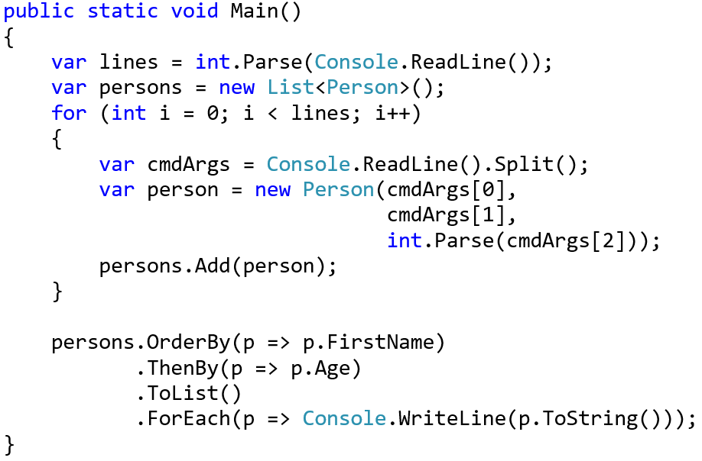
Problem: Sort Persons by Name and Age
Create a class Person
Person
-firstName:string
-lastName:string
-age:int
+FirstName():string
+Age():int
+toString():string

Slide 16
Solution: Sort Persons by Name and Age
public class Person {
private string firstName;
private string lastName;
private int age;
public string FirstName => return this.firstName;
public int Age => return this.lastName;
public override string ToString()
{
\\TODO: Add logic
}
}

Slide 17
Problem: Salary Increase
Expand Person with salary
Add getter for salary
Add method, which update salary with given percent
Persons younger than 30 get half increase than normal
Person
-firstName : string
-lastName : string
-age : int
-salary : double
+FirstName: string
+Age: int
+Salary: double
+IncreaseSalary(int):void
+ToString(): string

Slide 18
Solution: Getters and Setters
Expand Person from previous task
private double salary;
public void IncreaseSalary(double percent)
{
if (this.age > 30)
this.salary += this.salary * percent / 100;
else
this.salary += this.salary * percent / 200;
}
Check your solution here: https://judge.softuni.bg/Contests/Practice/Index/475#1

Slide 19

Validation

Slide 20
Validation
Setters are good place for simple data validation
Callers of your methods should take care of handling Exceptions
public double Salary
{
set
{
if (salary < 460)
throw new ArgumentException("...");
this.salary = value;
}
}
Throw exceptions, rather than printing to the Console
Notes:
Constructors are declared public
Constructors perform checks to keep the object state valid
Interface methods are always public
Not explicitly declared with public
Non-interface methods are declared private / protected

Slide 21
Validation (2)
Constructors use private setters with validation logic
Guarantee valid state of the object after its creation
public Person(string firstName, string lastName,
int age, double salary)
{
this.FirstName = firstName;
this.LastName = lastName;
this.Age = age;
this.Salary = salary;
}
Validation happens inside the setter
Notes:
Constructors are declared public
Constructors perform checks to keep the object state valid
Interface methods are always public
Not explicitly declared with public
Non-interface methods are declared private / protected

Slide 22

Problem: Validate Data
Expand Person with validation for every field
Names must be at least 3 symbols
Age cannot be zero or negative
Salary cannot be less than 460
Person
-firstName : String
-lastName : String
-age : Integer
-salary : Double
+Person()
+FirstName(string fname)
+LastName(string lname)
+Age(int age)
+Salary(double salary)

Slide 23
Solution: Validate Data
// TODO: Add validation for firstName
// TODO: Add validation for lastName
private void setAge(int age)
{
if (age < 1)
throw new ArgumentException("...");
this.age = age;
}
// TODO: Add validation for salary

Slide 24
Immutable Objects
When you have a reference to an instance of an object, the contents of that instance cannot be altered
string myString = "old String"
Console.WriteLine(myString);
myString.replaceAll("old", "new");
Console.WriteLine( myString );
old String
old String
Notes:
Fields are always declared private
Accessed through getters and setters in read-only or read-write mode
Setters perform checks to fight invalid data

Slide 25
Mutable Objects
When you have a reference to an instance of an object, the contents of that instance can be altered
Point myPoint = new Point( 0.0, 0.0 );
Console.WriteLine( myPoint );
myPoint.SetLocation( 1.0, 0.0 );
Console.WriteLine( myPoint );
0.0, 0.0
1.0, 0.0
Notes:
Fields are always declared private
Accessed through getters and setters in read-only or read-write mode
Setters perform checks to fight invalid data

Slide 26
Mutable Fields
private mutable fields are still not encapsulated
In this case you can access the field methods through the getter
class Team
{
private String name;
private List<Person> players;
public List<Person> Players
{
get { return this.players; }
}
}
Notes:
Fields are always declared private
Accessed through getters and setters in read-only or read-write mode
Setters perform checks to fight invalid data

Slide 27
Problem: First and Reserve Team
Expand your project with class Team
Team have two squads first team and reserve team
Read persons from console and add them to team
If they are younger than 40, they go to first squad
Print both squad sizes
Team
-name : string
-firstTeam: List<Person>
-reserveTeam: List<Person>
+Team(String name)
+Name(): string
+FirstTeam(): ReadOnlyList<Person>
+ReserveTeam: ReadOnlyList<Person>
+addPlayer(Person person)

Slide 28
Solution: Validate Data
private string name;
private List<Person> firstTeam;
private List<Person> reserveTeam;
public Team(string name)
{
this.name = name;
this.firstTeam = new List<Person>();
this.reserveTeam = new List<Person>();
}

Slide 29
Solution: Validate Data
public IReadOnlyCollection<Person> FirstTeam
{
get { return this.firstTeam.AsReadOnly(); }
}
//TODO: add getter for reserve team
public void AddPlayer(Person player)
{
if (player.Age < 40)
firstTeam.Add(player);
else
reserveTeam.Add(player);
}

Slide 30


Encapsulation – Benefits
Reduces complexity
Structural changes remain local
Allows validation and data binding
Notes:
Ensures that structural changes remain local
Changing the class internals does not break any outside code
Allows changing the internal class implementation

Slide 31

Summary
Encapsulation hides implementation
Access modifiers
Encapsulation reduces complexity
Ensures that structural changes remain local
Mutable objects
Immutable objects

Slide 32







Encapsulation
https://softuni.bg/courses/csharp-advanced

Slide 33
License
This course (slides, examples, demos, videos, homework, etc.) is licensed under the "Creative Commons Attribution-NonCommercial-ShareAlike 4.0 International" license
Attribution: this work may contain portions from
"Fundamentals of Computer Programming with C#" book by Svetlin Nakov & Co. under CC-BY-SA license
"C# Part I" course by Telerik Academy under CC-BY-NC-SA license
"C# Part II" course by Telerik Academy under CC-BY-NC-SA license

Slide 34





Trainings @ Software University (SoftUni)
Software University – High-Quality Education, Profession and Job for Software Developers
softuni.bg
Software University Foundation
http://softuni.foundation/
Software University @ Facebook
facebook.com/SoftwareUniversity
Software University Forums
forum.softuni.bg

